Slide 1



Comprehensive Analysis Of Debtor Payment Behavior and Default Risk Prediction For Fines Victoria
By Jay Sangani Prabhath Ummiti Master of Business Analytics, Monash University

Slide 2

Meet Our Team DAaS
John Gehman
James Farnell
Managing Technical Specialist.
Data Scientist
Hana Basyoni
Fiona Lu
Data Scientist
Data Analyst
Cameron Bolton
Allanagh O'Donnell
Data Analyst
Manager, Priority Projects
Lanny Tieu
DAaS and DGS Teams
Project Officer

Slide 3


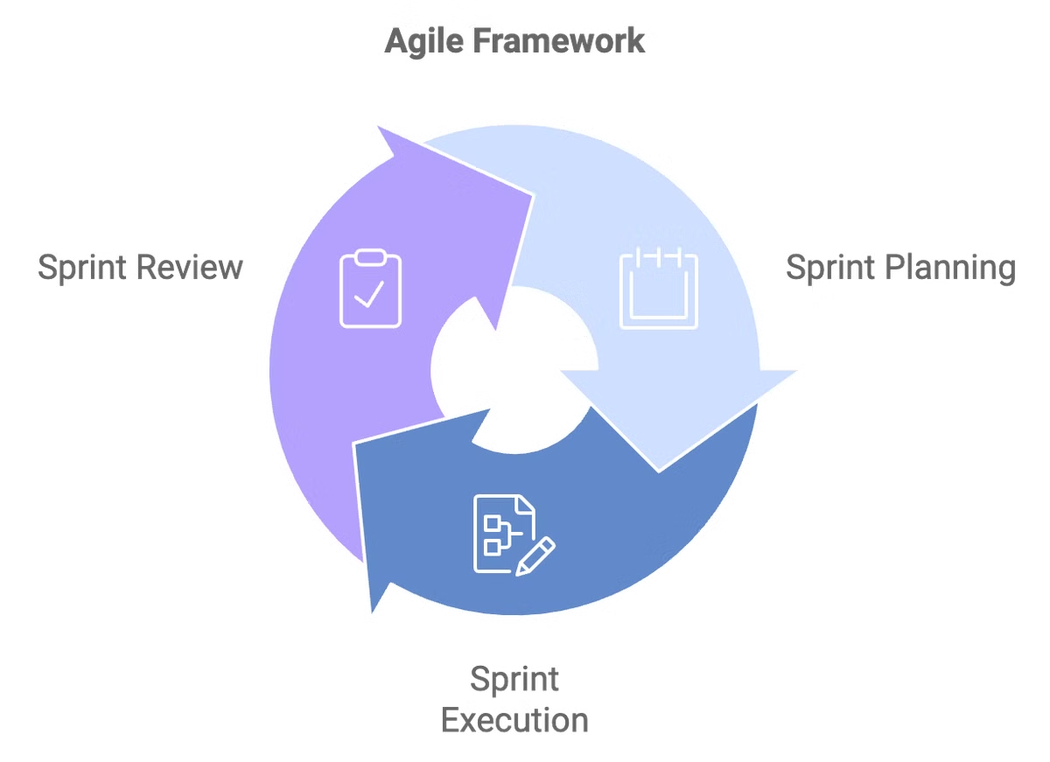






Tools and Workflow
Jira
GitLab
Task management platform.
Version control and collaboration.
Azure
SharePoint
Database management.
Document sharing and storage.
Postico
Visual Studio Code
Data access and collaboration.
Integrated development environment (IDE).
Python
SQL
Programming language for data analysis.
Query language for database management.

Slide 4
Project Overview
DAaS under DGS
Works on consulting projects for government agencies, delivering cost-effective solutions that streamline processes and achieve results at 50% of the cost of outsourcing to private companies.
Fines Victoria
Oversees the management and collection of fines across the state, ensuring compliance, managing payment arrangements, and striving to enhance the system for timely collections and financial stability.
The Challenge
Fines Victoria faces growing challenges with an increasing number of debtors defaulting on payments, which causes financial strain. Without predictive insights, they struggle to take proactive action.
The Project
Aims to develop a predictive model for debtor defaults using historical data, equipping Fines Victoria with actionable insights to better manage and reduce the risk of defaults.

Slide 5



The Problem
More Customers Defaulting
25-30% of those fined default on their payments.
1
Significant Increase in Fines
2
Over 2 million fines are issued every year, resulting in a $150 million shortfall in state revenue.
Burden on the Fines Victoria Team
3
Increased investment in resources and manpower is failing to reduce defaults and is further harming fine recovery and state cash flow.

Slide 6




The Solution
Streamlining Processes
Boosting Collections
Optimizing Resources
Financial Stability
Help the Victorian government maintain a more stable financial position.
Restructure Fines Victoria's processes to optimize efficiency and minimize delays.
Predict high-risk debtors to focus resources on targeted interventions.
Manage a larger volume of debtors with reduced staffing requirements.
Reduce the need to offset Fines Victoria's financial burdens.
Ensure a smoother and more effective debt collection system.
Lead to increased debt collection and a more sustainable financial outlook.
Free up resources for other critical initiatives.

Slide 7
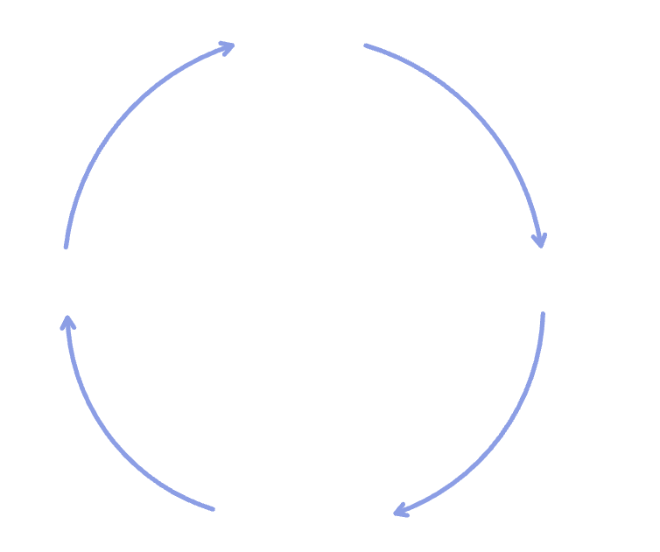
Our Methodology
Planning
Idea
1
Identify key variables and establish the model approach.
2
Implementation
Accuracy
Execution
Develop and execute the models, processing relevant data.
3
Optimization
Prediction
Refine and enhance models based on performance evaluation.

Slide 8
About The Data
1
2
3
Data Collection
Data Storage and Security
Dataset Overview
Source: Datasets provided by Fines Victoria.
Rows: 4.3 million entries.
Storage: Securely stored in Azure.
Columns: 52 columns.
Data Types: Numeric, categorical, and datetime columns.
Hashing: Dataset was hashed to ensure debtor privacy and confidentiality
Access: Analyzed using Postico.
Security: Ensured by not pushing the dataset to GitLab.

Slide 9
Initial Data Analysis (IDA)
Missing Values
Data Types
Outliers
Identified and handled missing values across relevant columns.
Verified correct data types (e.g., dates, numeric).
Detected and flagged potential outliers in payment-related variables.
Basic Statistics
Data Cleaning
Summarized key metrics such as mean, median, and distribution.
Addressed inconsistencies like invalid date ranges or negative balances.

Slide 10
What made us decide on fitting the model?
Stakeholder Discussion: In a meeting with stakeholders at Fines Victoria, the key challenge identified was the difficulty in predicting debtor defaults, which was impacting their collection process.
Problem Identification: The team realized that understanding and predicting debtor behavior could help address these issues.
Decision to Model: We decided to train a predictive model based on debtors' past behavior, aiming to help Fines Victoria improve their strategies for managing debts and reducing the number of defaulters.
What are we trying to predict with the model?
Primary Objective: Predict whether a debtor will default based on past payment behavior.
Focus on PA_Status: The model targets the "Cancelled - Defaulted" status in the PA_Status variable to identify patterns that lead to defaults.
Outcome: Accurate prediction of defaulters will enable Fines Victoria to take early intervention measures, improving collection processes and reducing financial losses.

Slide 11

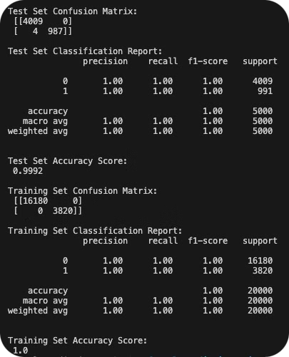
First model
First Model Setup: The initial model was trained with 52 variables without much refinement or evaluation of data quality.
Overfitting Issue:
Training Set: Perfect classification with an accuracy of 100%.
Test Set: Nearly perfect accuracy of 99.9%.
Such results typically indicate overfitting, where the model has memorized the training data but lacks generalization ability.
Key Insight: While both precision and recall are perfect, this model is too tightly fitted to the specific training data, making it unreliable for unseen cases in real-world applications.
Next Step: We recognized the need for feature selection, engineering, and other data improvements to prevent overfitting and achieve better generalization.

Slide 12
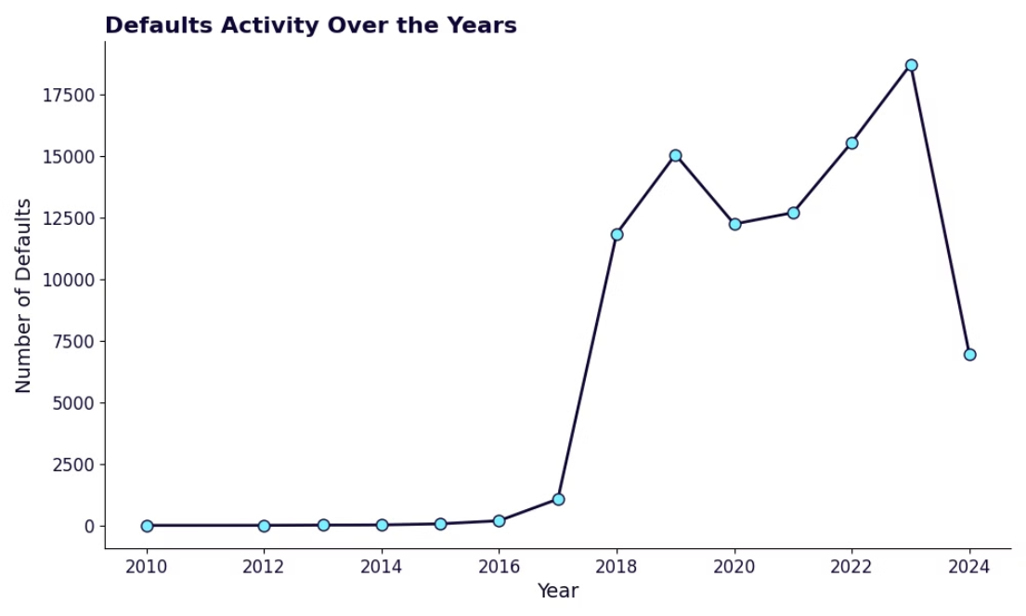
Time Series Plot
Observation: A sharp rise in defaults starts in 2018, peaking in 2023 before a decline.
Insight: The spike from 2018 onward indicates a critical period for analyzing defaults.
Decision: We trimmed the dataset from 2018 to focus on significant default activity for a more precise analysis.

Slide 13
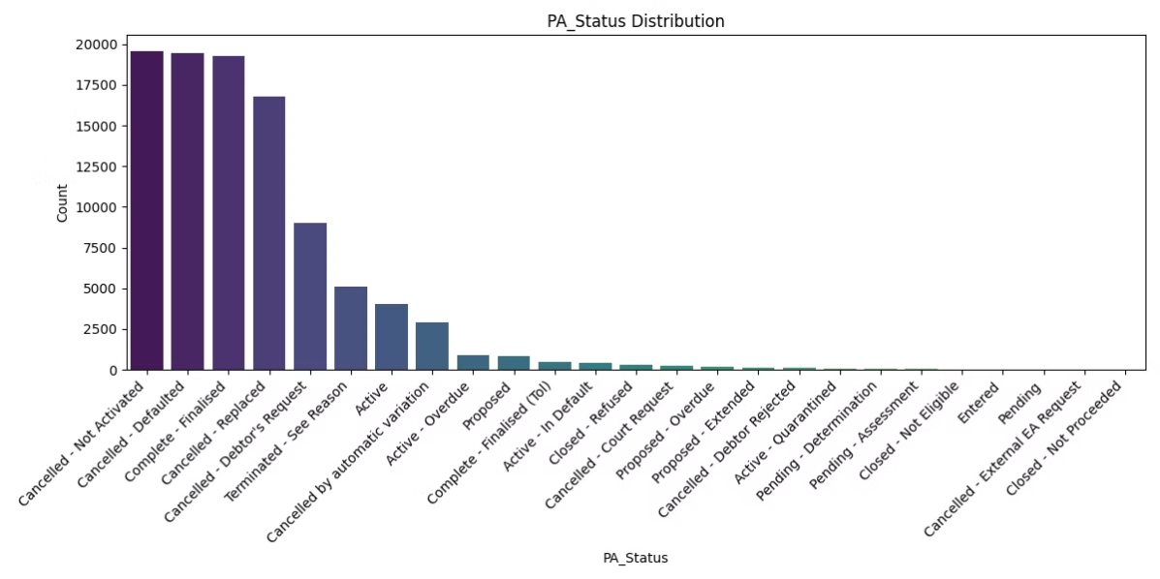
EDA: Feature Reduction
Introduction to PA_Status: The payment arrangement status (PA_Status) is a critical variable in determining whether debtors have defaulted. The distribution of this status gives insights into the overall dataset and the proportion of defaulters versus non-defaulters.
Insights:
The majority of debtors in the dataset have non-default statuses, with "Cancelled - Defaulted" representing a smaller portion.
This imbalance highlights the importance of ensuring correct default predictions.

Slide 14
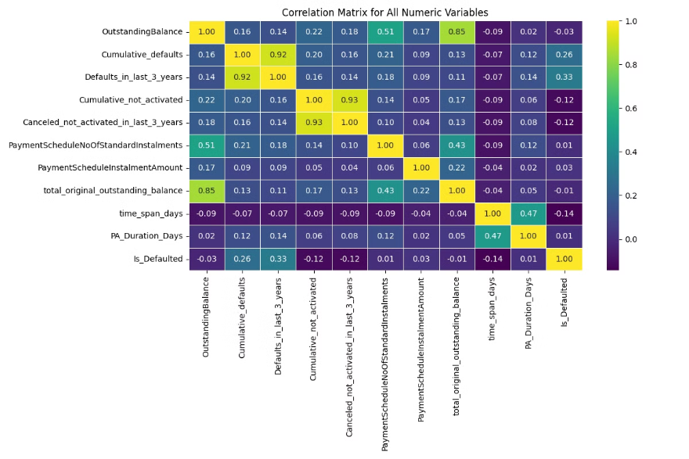
EDA: Correlation Matrix of Key Features
Content:
Correlation Insights: Exploring correlations between key numerical features helps identify relationships between variables that might influence default predictions.
Key Correlations:
OutstandingBalance and Cumulative_defaults show moderate positive correlations.
PA_Duration_Days has correlations with PaymentScheduleInstalmentAmount and OutstandingBalance, indicating that the duration of a payment arrangement could impact the total outstanding balance.
Visual:
Heatmap: Correlation matrix of all numeric variables with detailed annotations.
This heatmap allows quick identification of strongly correlated features for model consideration.

Slide 15
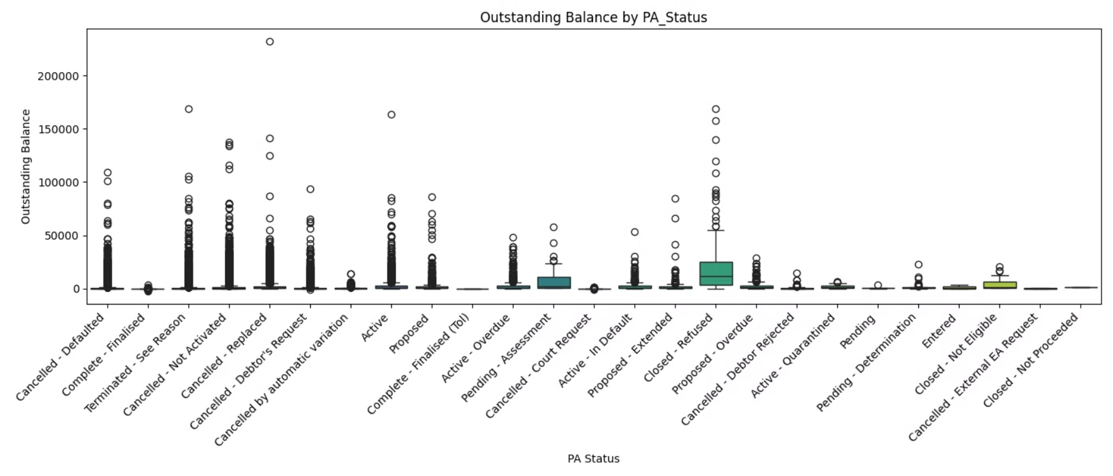
EDA: Outstanding Balance by PA_Status
Wide Range of Balances: Significant variation in outstanding balances across different statuses.
High Outliers: Some statuses (e.g., defaults, canceled) show high outliers, indicating large unpaid amounts.
Shows how outstanding balances vary across different PA statuses.

Slide 16

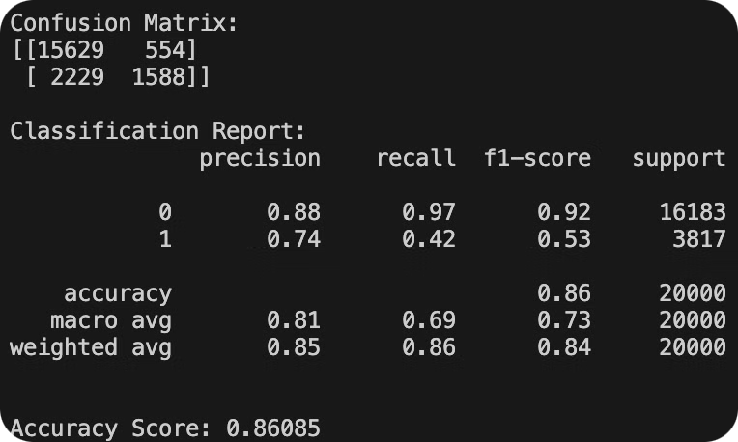
Modeling and Focus on Default Detection
Model Overview: The RandomForest model shows an overall accuracy of 86%.
Key Insight: We are less concerned about the overall accuracy, as the primary goal is to improve the model's ability to detect defaults (class 1).
Confusion Matrix Analysis:
Correctly classified 1,588 defaulters, but missed 2,229 actual defaults.
Precision for defaulters (class 1) is 0.74, while recall is 0.42, indicating room for improvement in identifying more defaulters.
Next Step: Feature engineering will be applied to enhance the model’s default detection capability.

Slide 17
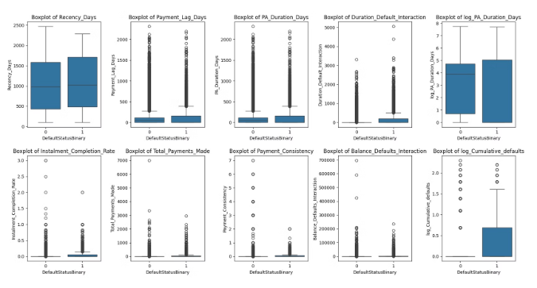
Key Feature Analysis through Pairplots and Boxplots
Pairplot Analysis: The pairplot visualizes relationships between key variables such as OutstandingBalance, PaymentScheduleInstalmentAmount, Cumulative_defaults, and PA_Duration_Days across the defaulted and non-defaulted groups.
Boxplot Analysis: The boxplot illustrates the differences in OutstandingBalance across the PA_Status categories, revealing that higher balances are more prevalent in default cases.
Visual:
Pairplot: Showcasing relationships between key variables and their interaction with default status.
Boxplot: Distribution of OutstandingBalance across PA_Status categories, emphasizing the difference between defaulted and non-defaulted debtors.

Slide 18

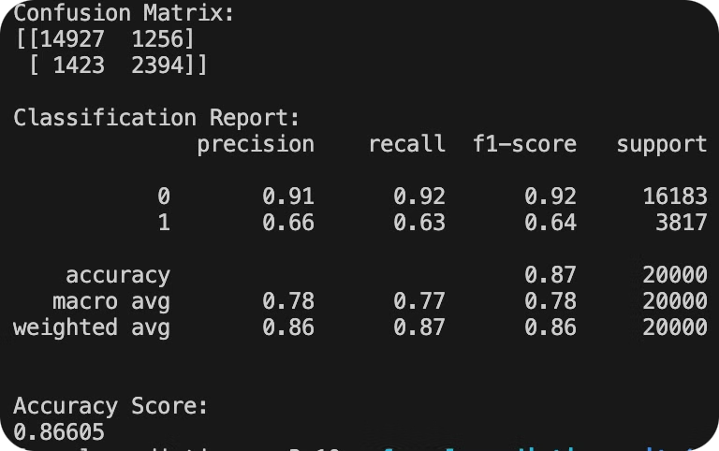
Results after feature engineering
Improvement in Precision: The precision for defaulters (class 1) increased to 0.74, meaning when the model predicts a default, it's more likely to be correct.
Consistent Overall Accuracy: The model's overall accuracy remains strong at 0.86085.
Persistent Recall Issue: The recall for defaulters dropped to 0.42, indicating the model still fails to identify a significant number of actual defaulters.
Key Concern: Misclassification of defaulters as non-defaulters remains a major issue that needs to be resolved to improve default prediction.

Slide 19

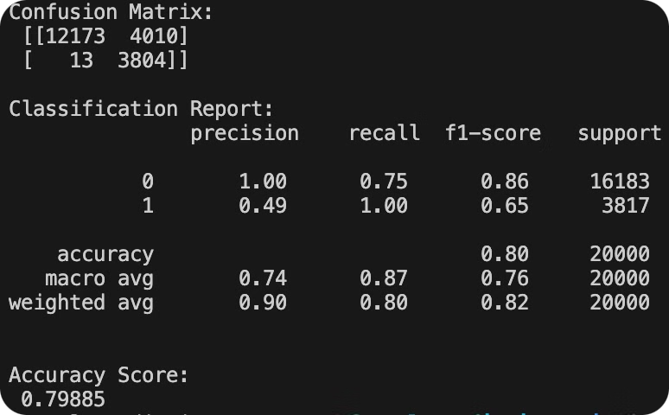
Model Performance After Tuning
Tuning:
SMOTE: Oversampled the minority class (defaulters) to handle class imbalance.
Class Weighting: Penalized the model for misclassifying defaulters with a 1:3 weight ratio.
Threshold Adjustment: Tuned the classification threshold to 0.4 for better recall of defaulters.
Results:
Recall for Defaulters: Improved to 1.00, correctly identifying all defaulters.
Precision for Defaulters: Dropped to 0.49, but recall was prioritized.
Accuracy: Decreased to 79.88%, but the goal of predicting defaulters accurately was achieved.

Slide 20
What we solved and how it is beneficial to the team?
Improved Default Prediction: We enhanced the ability to predict which debtors are likely to default, allowing for more accurate identification of those at risk.
Actionable Insights: The model now provides useful insights that can help Fines Victoria take early action on high-risk debtors, improving debt collection strategies.
Business Impact: By predicting defaulters more effectively, Fines Victoria can focus efforts on key cases, reduce financial losses, and manage debts more efficiently.
Overall Value to the Project: The solution offers better decision-making tools that will lead to improved processes, contributing to the overall success of Fines Victoria's debt recovery initiatives.

Slide 21
Limitations and Challenges
1
Limited Data on Defaulters
2
Prediction Trade-off
3
Real-World Application Challenges:
While we improved the model's ability to predict defaulters, it led to a decrease in the accuracy of predicting non-defaulters. The model requires further development to achieve balanced accuracy for both classes
The dataset had a limited number of defaulters, which impacted the ability to train the model effectively for predicting defaults.
The model, while predictive, may face challenges in real-time application due to dynamic changes in debtor behavior that may not be captured in the historical data.

Slide 22
Conclusion
Successfully built a predictive model to identify potential debtor defaults based on historical data.
Achieved notable improvement in defaulter prediction through feature engineering and tuning techniques.
However, trade-offs were observed in predicting non-defaulters, highlighting the need for further optimization.
The model serves as a valuable tool for Fines Victoria to take proactive actions, though ongoing refinement is required to balance prediction accuracy across both defaulters and non-defaulters.

Slide 23

Thank You
We are open for discussion

